Slide 1

Multiple Client-Server system
PROGRAMMING PRACTICUM (CS-571)
FINAL PROJECT
ANIKA SHRIVASTAVA, Mtech(R) CSP, S22006
YASHI YADAV, M. Sc. Mathematics, V21066
Supervisor: Dr. Padmanabhan Rajan
DATE: 22nd November, 2022

Slide 2
problem STATEMENT
To design a multiple-client server system based basic arithmetic quiz game in which the client sends request for connection to the server and then the server starts the game by sending a total of 10 questions one after the other to the client and keeps track of the marks at every correct or wrong answer. For every correct answer, the client gets +1 mark and for every wrong answer, 0.25 marks is deducted. It closes the program after sending total marks to each of the client. This has to be done for multiple clients.

Slide 3
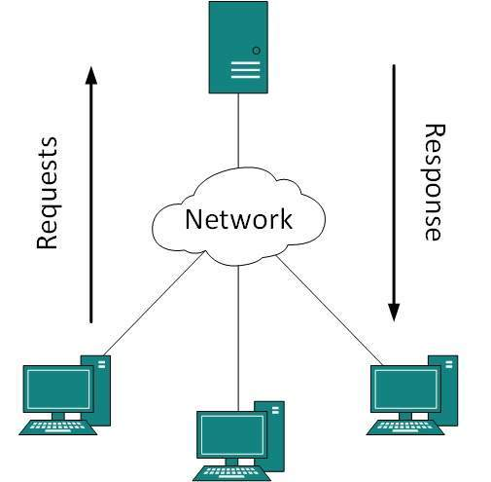
what is a client-server system?
Client-Server system is basically the backbone of web browsing. We come across different types of client-server connections in our day-to-day life.
The simplest example would be Google Search, it basically connects a client (i.e., user) to a server (i.e., Google Search) and provides the client with the information it needs.
For implementing the same, we used Socket Programming –
Socket programming is a way of connecting two nodes on a network to communicate with each other. One socket(node) listens on a particular port at an IP, while the other socket reaches out to the other to form a connection. Socket is the endpoint of a bidirectional communication channel between server and client.
Also, for handling multiple clients, we used MultiThreading, which is defined as the ability of a processor to execute multiple threads concurrently.

Slide 4
How does the client-server work?
Client raises the request to the server or service.
Server receives the request.
Server processes the request.
Server prepares the response and sends it back to the Client.
Client parses the response.
Request response process is completed.

Slide 5
USER MANUAL
In order to execute this program, you need to follow the below steps sequentially :
Download the Server.py and Client.py file in your local machine.
Open both the programs in any local IDE.
The program is designed to run on the same machine, so host and port addresses will be modified accordingly.
Run the Server.py script in Python application.
Run the Client.py script in Python application.
Read the rules of the game in the client terminal.
Enter your response YES or NO and press Enter key.
Input= YES, the game will start.
Input= NO, the game does not starts.
Enter your name in the client terminal.
Input your answer for every question.
Your marks will be displayed on the client terminal at the end of the game.

Slide 6
THANK YOU !

